Slide 1
Enabling machine learning in embedded systems
Rod Burns, Developer Relations, Codeplay Software

Slide 2
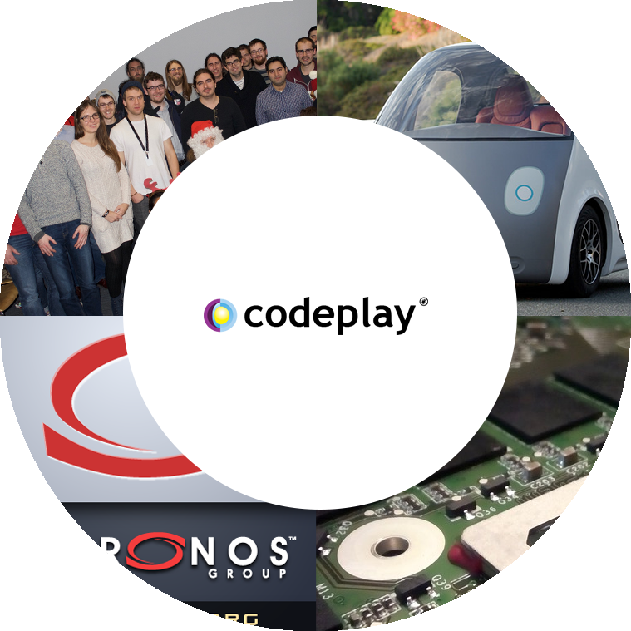









Leadership Products Enabling Advanced Applications on Complex Processor Systems
Company
Markets
High-performance software solutions for custom heterogeneous systems
Enabling the toughest processor systems with open-standards-based tools and middleware
Established 2002 in Scotland, UK
Vision Processing Machine Learning Data Compute
High Performance Computing (HPC) Automotive (ISO 26262) IoT, Smartphones & Tablets Medical & Industrial
Products
Customers/Partners
C++ platform with SYCL™, enabling vision
& machine learning e.g. TensorFlow™
The heart of Codeplay's compute technology, enabling OpenCL™, SPIR™, HSA™ and Vulkan™
Many Global Companies
Notes:
Codeplay is internationally recognized for expertise in Heterogeneous Systems, and has many years of experience in the development of Compilers, Runtimes, Debuggers, Test Systems, and other specialized tools.
Codeplay has delivered standards-compliant systems for some of the largest semiconductor companies in the world, focusing specifically on high-performance heterogeneous processor solutions for CPUs, GPUs, DSPs, FPGAs and other specialized imaging and vision processors. Working within The Khronos™ Group to define new open standards such as OpenCL™, SPIR™, SYCL™, and Vulkan®, and leading the creation of new System Runtime and Tools standards through the HSA Foundation, Codeplay has earned a reputation as one of the leaders in compute systems.

Slide 3


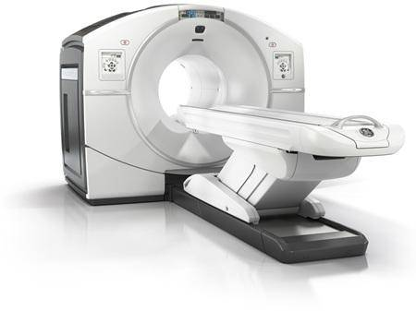
Connected Artificial Intelligence
What do these artificial intelligence applications have in common?

Slide 4
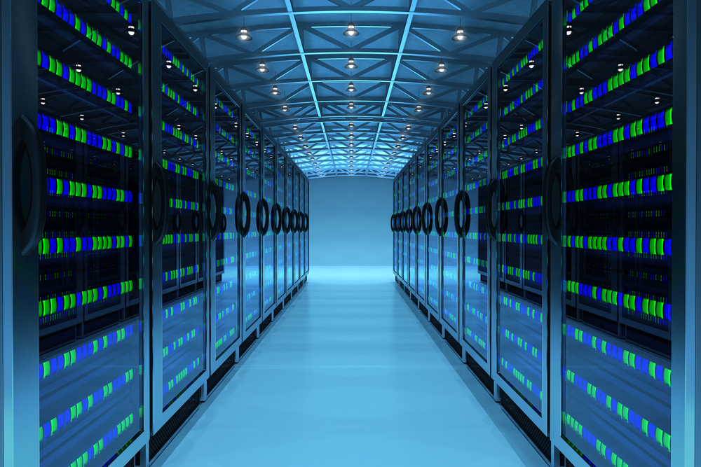
Connected - Powerful - Power Hungry
High bandwidth connectivity
Access to powerful machines
No power constraints

Slide 5
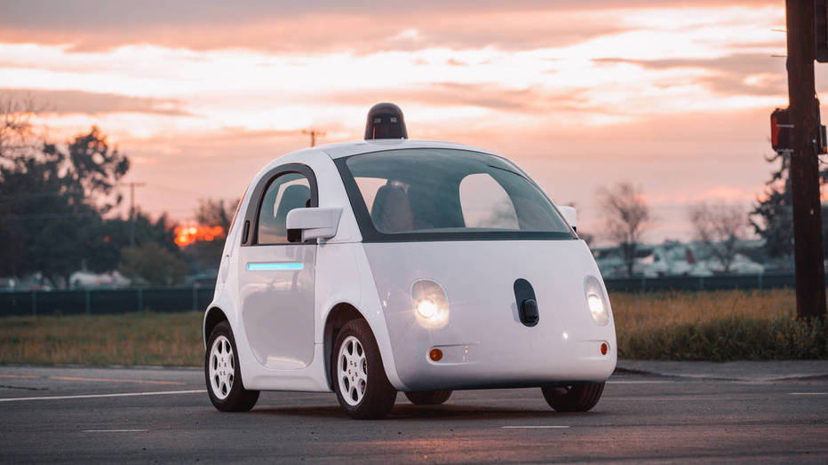
Embedded Machine Learning
Cannot rely on connectivity
More limited processors
Power constrained

Slide 6
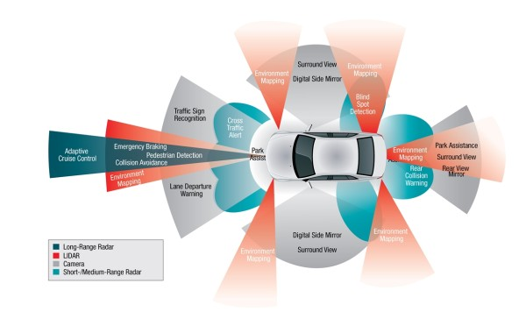
Provides A Unique Challenge
This car needs to be able to process all this data and make instant decisions

Slide 7
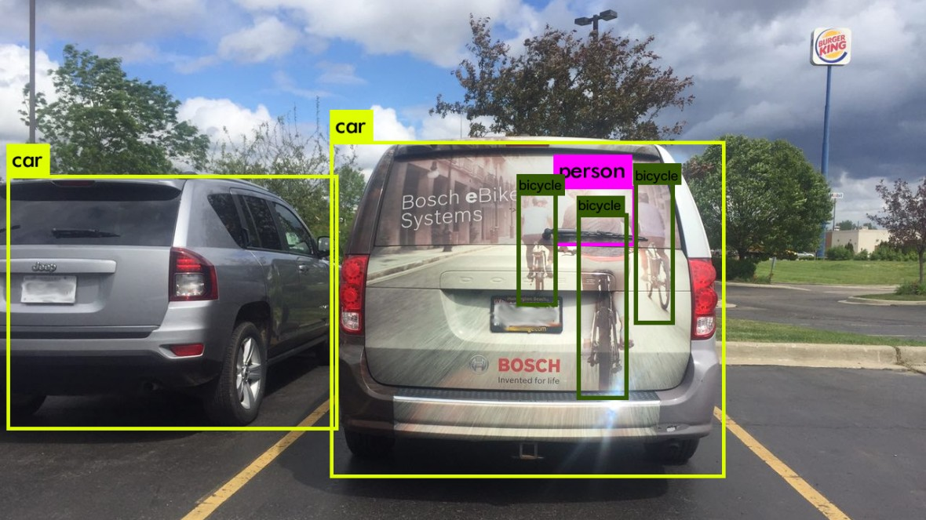
Why Different Sensors Are Needed?
The car needs multiple data sets to make decisions
This data needs to be processed

Slide 8
Where Do We Need To Go?
“On a 100 millimetre-squared chip, Google needs something like 50 teraflops of performance”
- Daniel Rosenband
(Google’s self-driving car project) at HotChips 2016
Desktop GPU (200W+)
Desktop CPU
Integrated Desktop GPU (~15W)
GFLOPS
Mobile CPU
Smartphone GPU (~2W)
These trend lines seem to violate the rules of physics…
Year of introduction

Slide 9
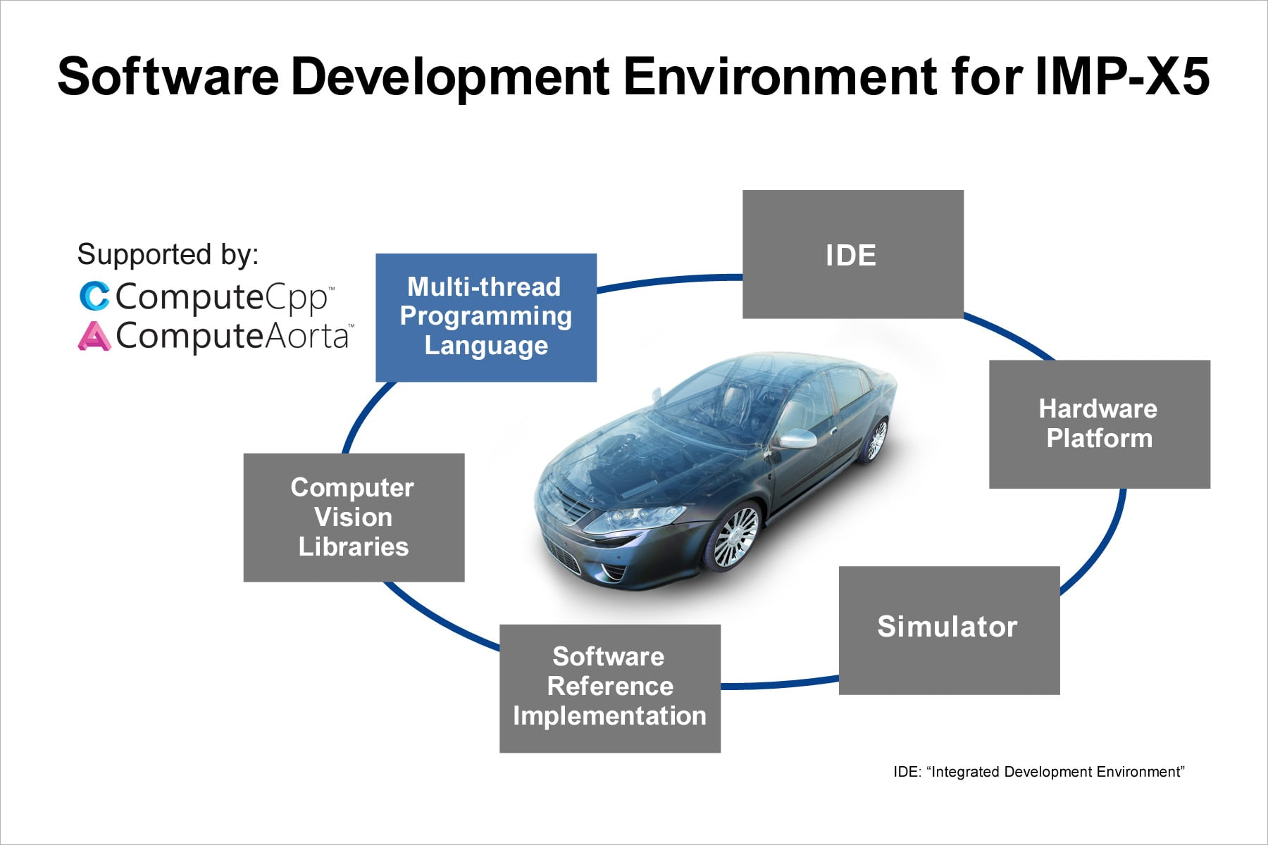
Software Drives Us Towards This Target
What do software developers need, to build complex applications for AI?

Slide 10

How Can Software Get Us There?
Deep neural networks are bringing the reality of these systems closer
We must make effective use of processors

Slide 11
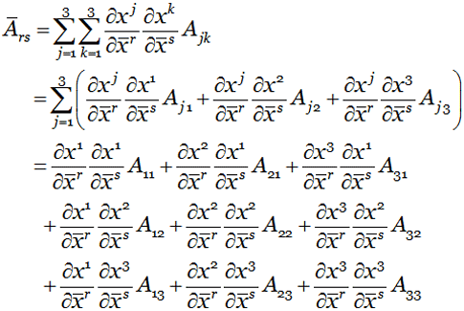
Tensors
Tensors are n-dimensional matrices represented by arrays
Calculations on matrices can be done using linear algebra
These operations are complex and processor intensive

Slide 12
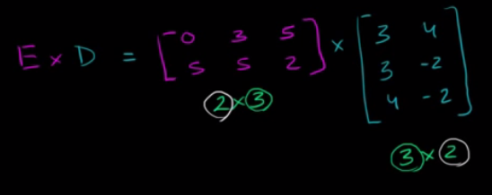
Linear Algebra
TensorFlow relies heavily on linear algebra for processing
This involves many matrix calculations
Matrix calculations are processor intensive

Slide 13
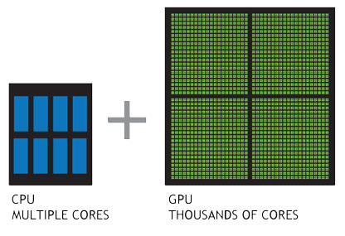
Heterogeneous Systems
GPUs can be used to run operations in parallel
Accelerates performance
Reduces overall power used

Slide 14
Implications On Hardware
22222222222222222222
22222222222222222222
22222222222222222222
22222222222222222222
22222222222222222222
22222222222222222222
22222222222222222222
22222222222222222222
22222222222222222222
CPU
Matrix calculations involve many similar operations
Run serially these operations are limited to a small number of cores on a CPU
2*3
2*3
2*3
2*3
333333333333333333333333333333333333333333333333333333333333333333333333333333333333333333333333333333333333333333333333333333333333333333333333333333333333333333333333333333333333
GPU
… n more rows

Slide 15
Implications On Hardware
22222222222222222222
22222222222222222222
22222222222222222222
22222222222222222222
22222222222222222222
22222222222222222222
22222222222222222222
22222222222222222222
22222222222222222222
CPU
A GPU or other accelerator can run many thousand operations in parallel
333333333333333333333333333333333333333333333333333333333333333333333333333333333333333333333333333333333333333333333333333333333333333333333333333333333333333333333333333333333333
GPU
… n more rows

Slide 16
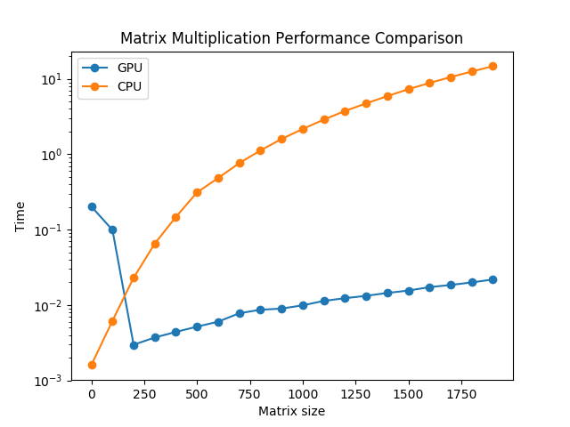
What Does This Mean For TensorFlow
Since linear algebra involves many similar calculations on data sets these can be run in parallel on GPUs and other accelerator processors
https://xiaoxiaowang87.github.io/build_a_pc/

Slide 17

TensorFlow And Eigen
TensorFlow uses the Eigen library for linear algebra operations
Eigen offers additional performance benefits

Slide 18
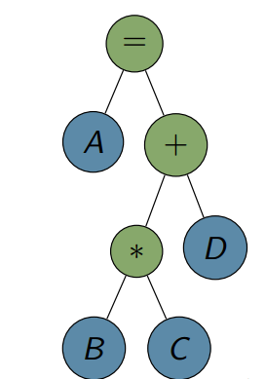
Kernel Fusion
The Eigen library uses kernel fusion
This involves executing a sequence of kernels that can share some data
This reduces the overhead of memory movement

Slide 19
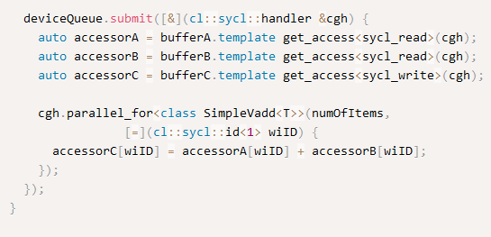
What Is A kernel?
A kernel is a function that is applied on some data
As a simple example we could have a kernel that does C = A + B
This kernel iterates over all the data provided to it

Slide 20
Combining Kernels
These operations can be combined and run together
This avoids expensive memory movement overheads

Slide 21
Applying Fusion To TensorFlow Eigen
TensorFlow uses Eigen to achieve kernel-fusion
CUDA does this for NVIDIA GPUs, SYCL is used here for AMD GPUs
Speedup by fusion
Speedup by fusion
Speedup by fusion
Speedup by fusion
Unfused performance improvement: AMD GPU vs multi-core Intel CPU
Total performance improvement delivered by SYCL is both of these graphs combined

Slide 22
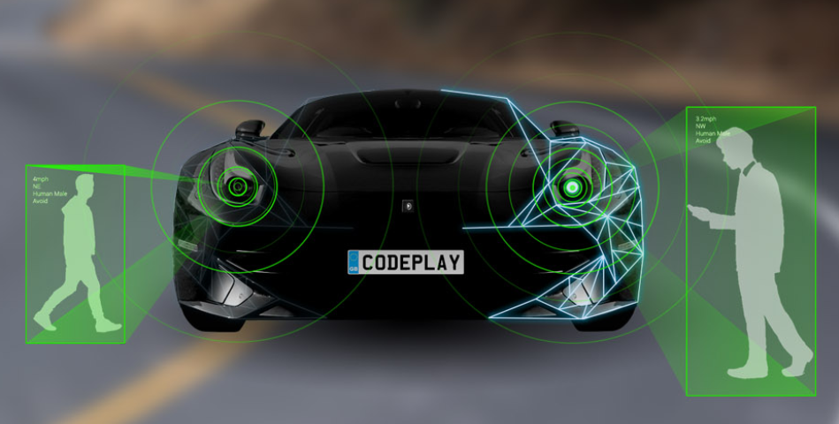
Implications For Embedded Applications
Embedded hardware is less powerful than in a data centre
Increased performance and reduced power usage makes more complex AI applications possible

Slide 23



Open Standards For Hardware
Software developers need a consistent environment and interface for developing AI applications

Slide 24
OpenCL And SYCL
OpenCL ™
Cross-platform parallel programming for a range of processors
Developers use C for programming hardware
ComputeAorta implementation from Codeplay
SYCL ™
Higher level abstraction of OpenCL
Modern C++ supported and single source
ComputeCpp implementation used for TensorFlow with OpenCL
TriSYCL - alternative implementation

Slide 25
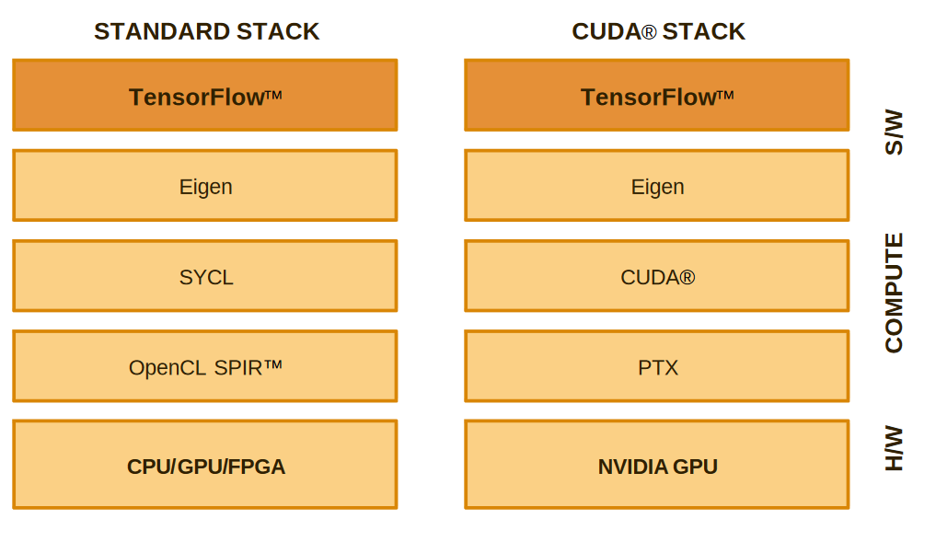
Integration With TensorFlow
Eigen is a C++ library, OpenCL does not support C++
Templates in Eigen can be re-used with SYCL

Slide 26
Benefits Of SYCL Integration
Devices already offering OpenCL SPIR/SPIR-V support can be targeted
New TensorFlow operations can be added using C++
The interfaces remain the same between layers

Slide 27
Benefits For Developers
TensorFlow applications will be accelerated without any special coding
Developers can target a wider choice of hardware
Support for embedded hardware processors

Slide 28
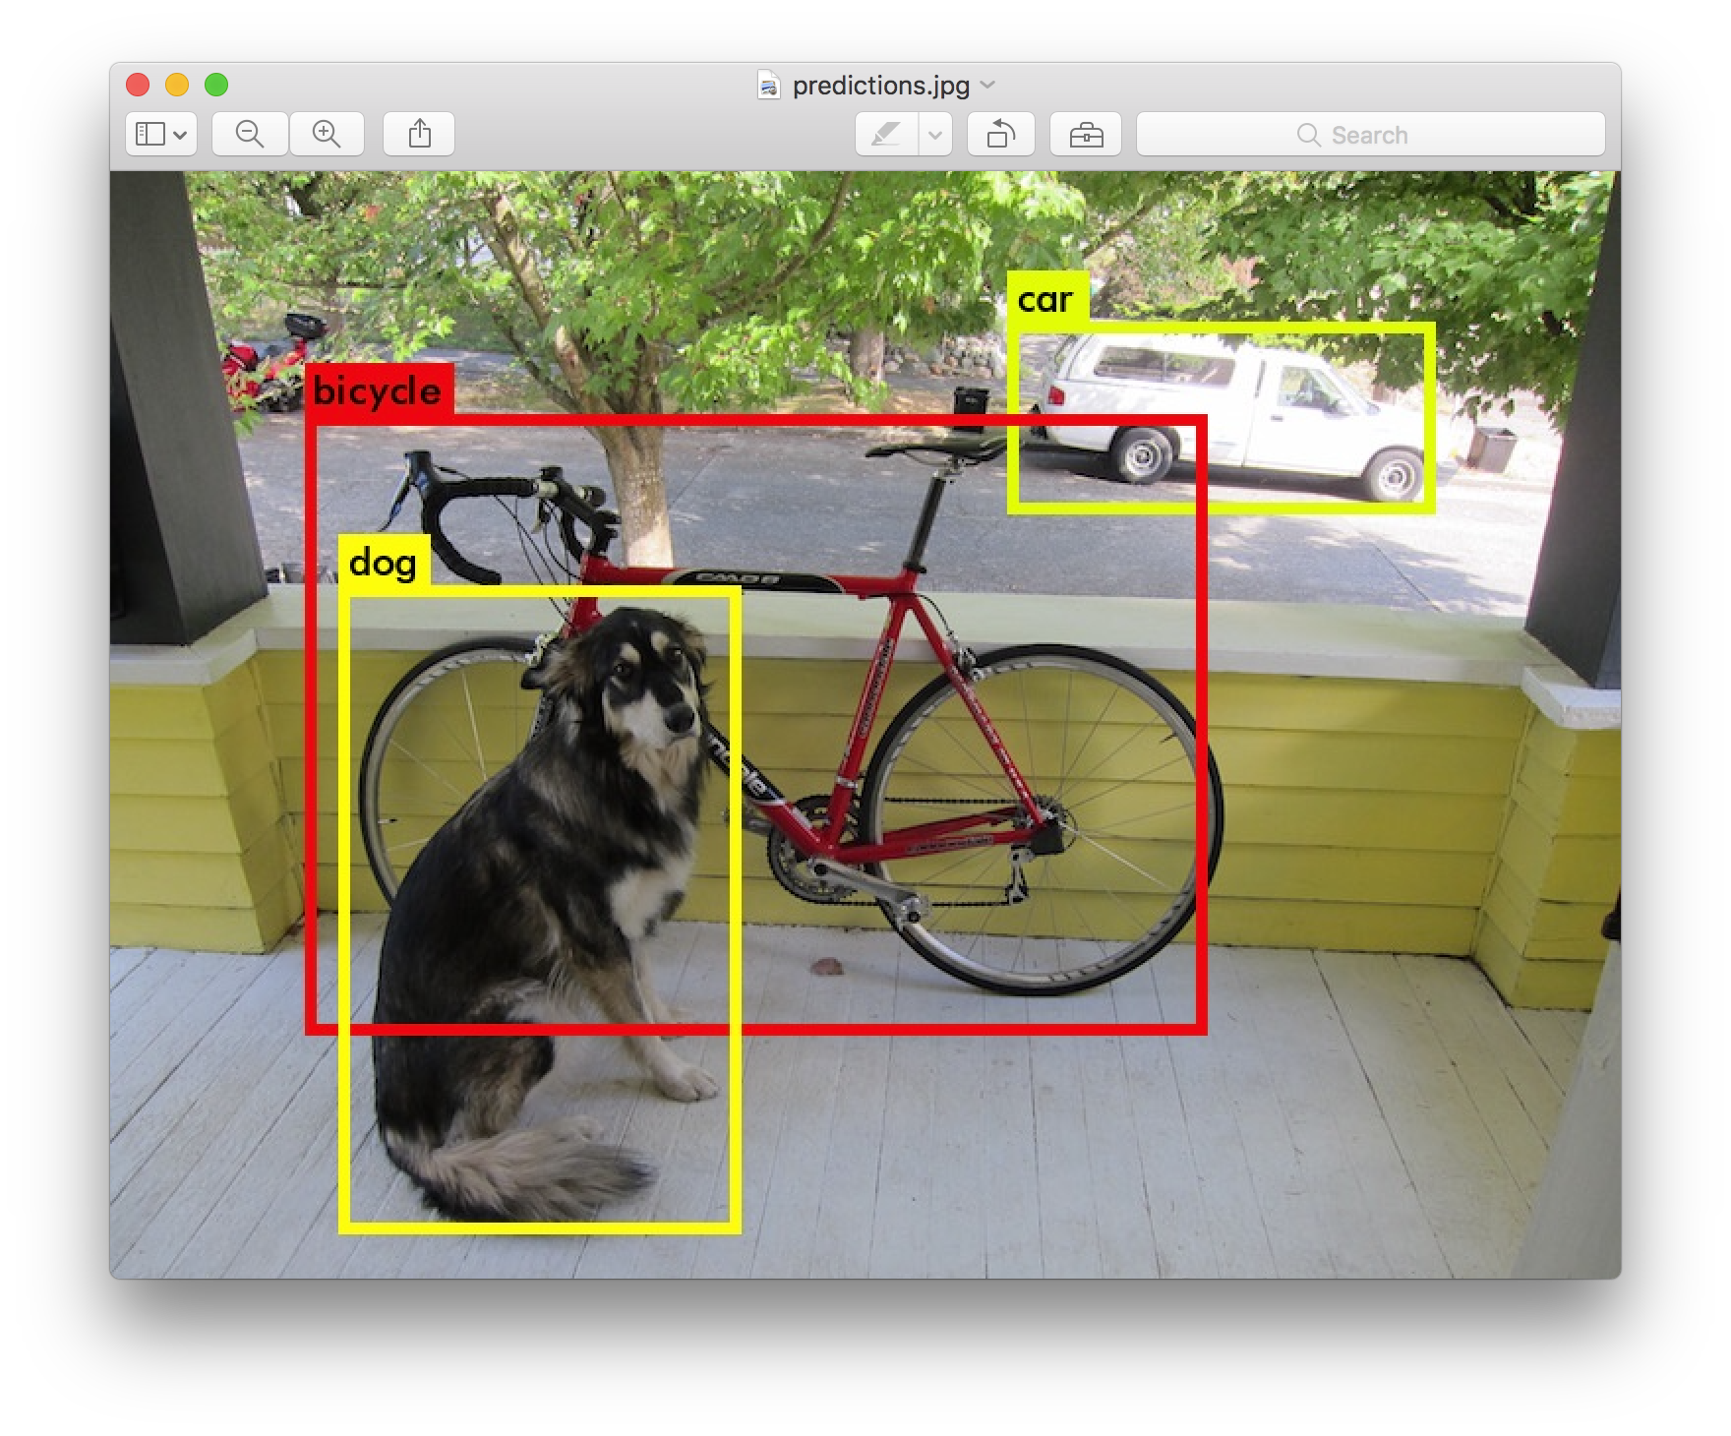
Beyond TensorFlow
We are working on integrating OpenCV, Caffe(2) and other AI frameworks on embedded hardware
We use open standards OpenCL and SYCL to achieve this

Slide 29
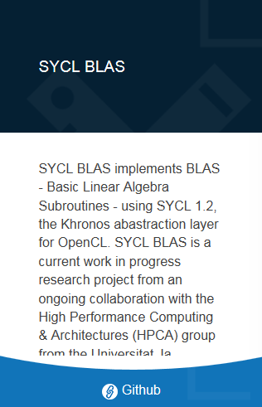
SYCLBLAS
Our research team is building a BLAS framework using SYCL
This has the potential to enable many deep learning frameworks on OpenCL hardware

Slide 30









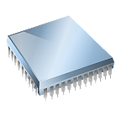
Our Solution Stack
via
LLVM
LLVM
LLVM
LLVM
CPU
DSP
GPU
FPGA

Slide 31
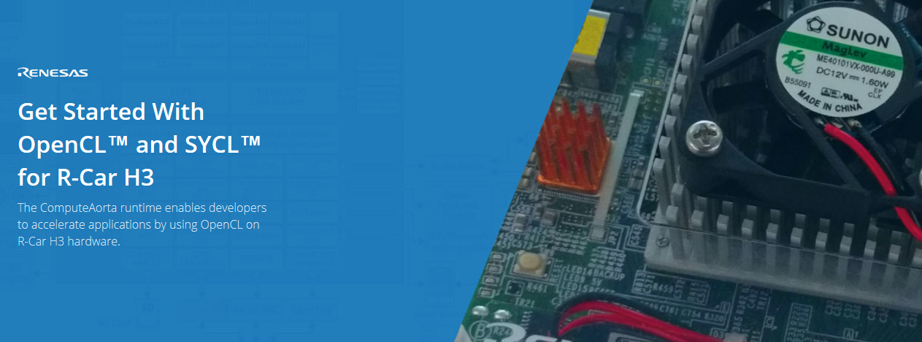
Renesas R-Car With OpenCL And SYCL
We are enabling AI frameworks including OpenCV and TensorFlow on Renesas R-Car hardware
http://developer.codeplay.com

Slide 32
Combining open standards to deliver platforms for software developers
C++ single-source lets us create customizable graph models
Single-source is most widely-adopted machine learning programming model
OpenCL lets us run on a very wide range of accelerators now and in the future
SYCL combines C++ single-source with OpenCL acceleration

Slide 33

Open Standards For AI
Talk to me about open standards with TensorFlow and other AI frameworks on embedded hardware
rod@codeplay.com

